Slide 1
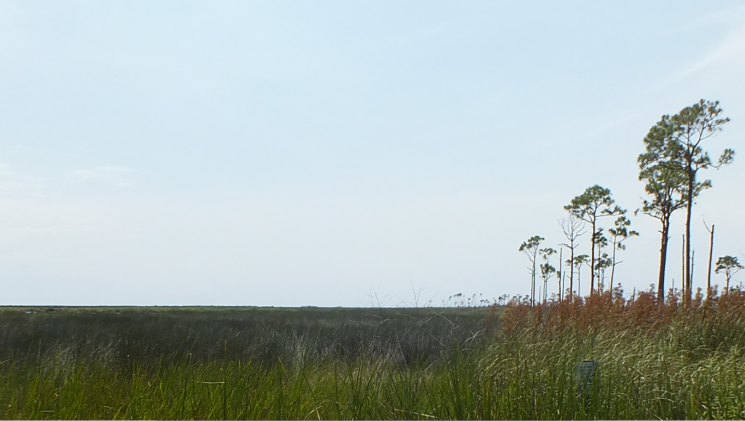

Coastal Land Loss and Landscape Level Plant Community Succession: An Expected Result of
Natural Tectonic Subsidence, Fault Movement and Sea Level Rise
by
Kathleen S. Haggar
Riparian, Inc.
Baton Rouge, LA
Upper Goose Point Marsh 2013

Slide 2
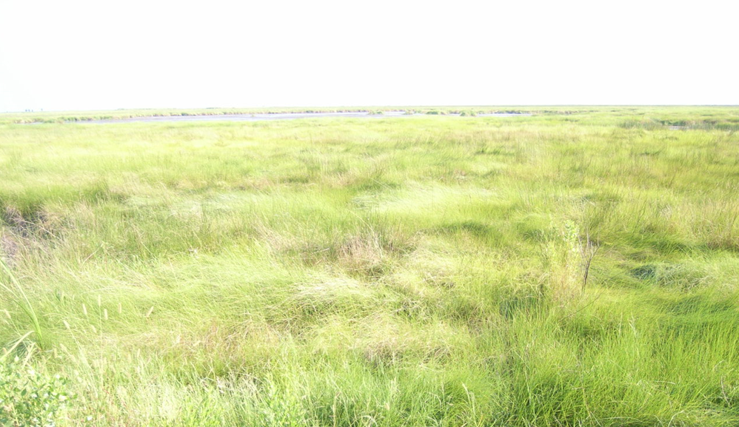
Outline
Introduction
Geologic Setting
Factors Influencing Land Change
      Anthropogenic
      Natural - geology driven
      Marsh Response
Summary

Slide 3
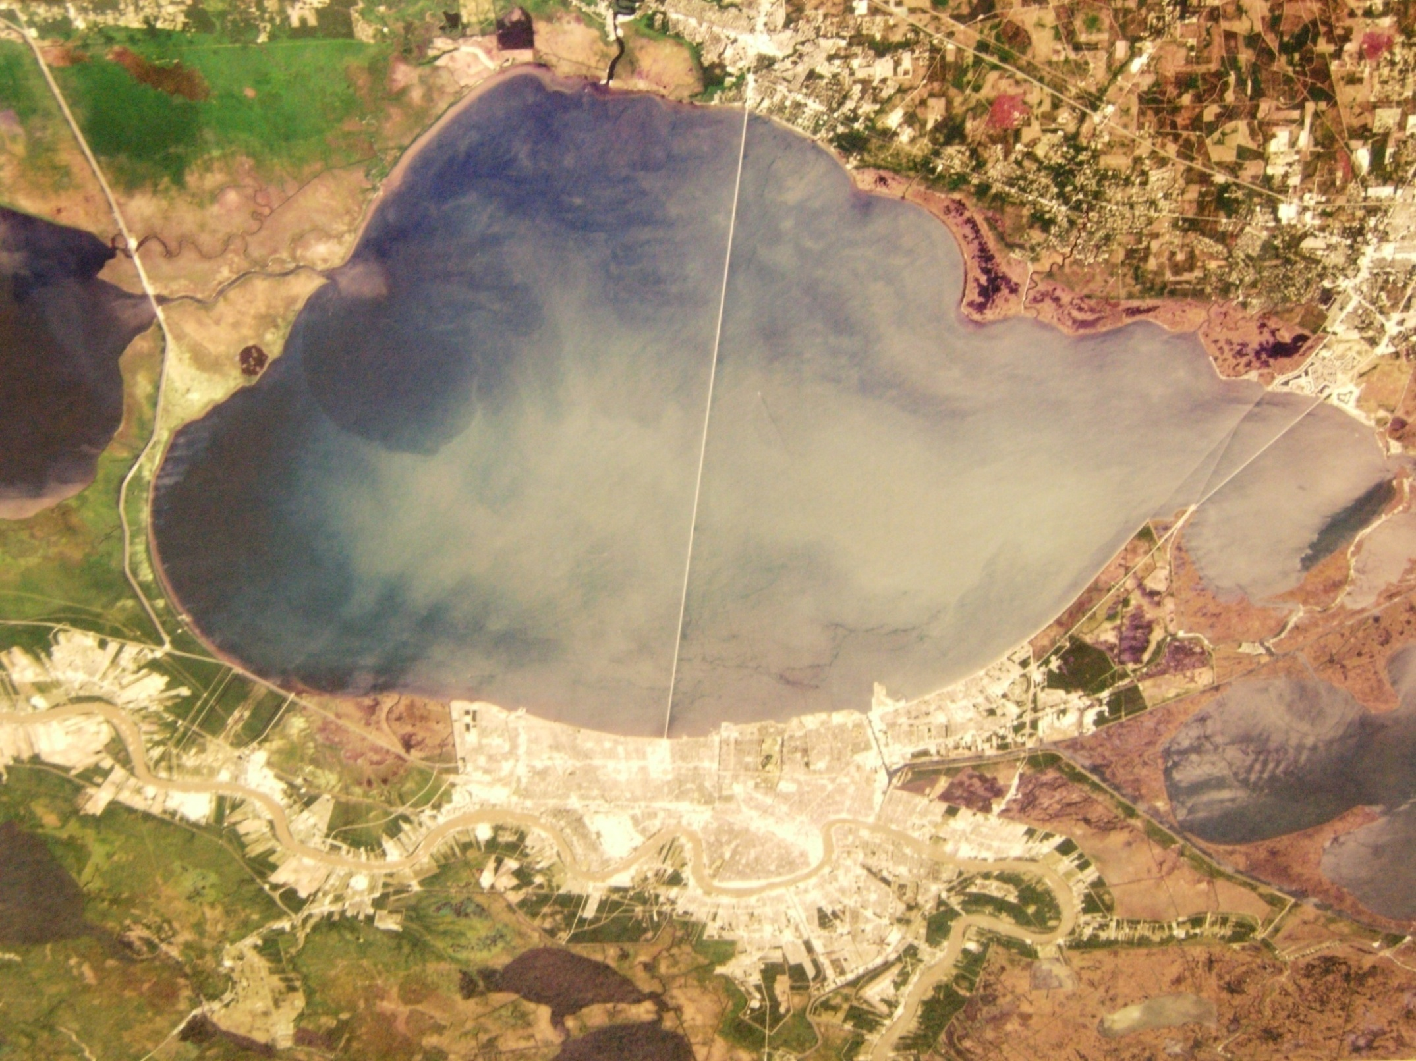
Mandeville
Tchefuncte River
Lacombe
Pass Manchac
Lake
Maurepas
Slidell
Goose Point
Lake Pontchartrain
Rigolets Pass
Chef Menteur Pass
Water Way
IHNC
Mississippi River
Intracoastal
Lake Borgne
Lac Des Allemands
MRGO
Lake Cataouatchie
L. Lery
Lake Salvador
NASA Satellite Earth Immagry 1992
Notes:
Lake Pontchartrain is down thrown to the Baton Rouge Fault. The south shore was deposited by the Mississippi River and its Recent ancestors, but the north shore sediments are older, Pleistocene. The area downthrown to the Baton Rouge Fault has a thin veneer of Recent sediments.

Slide 4
Geologic Setting

Slide 5
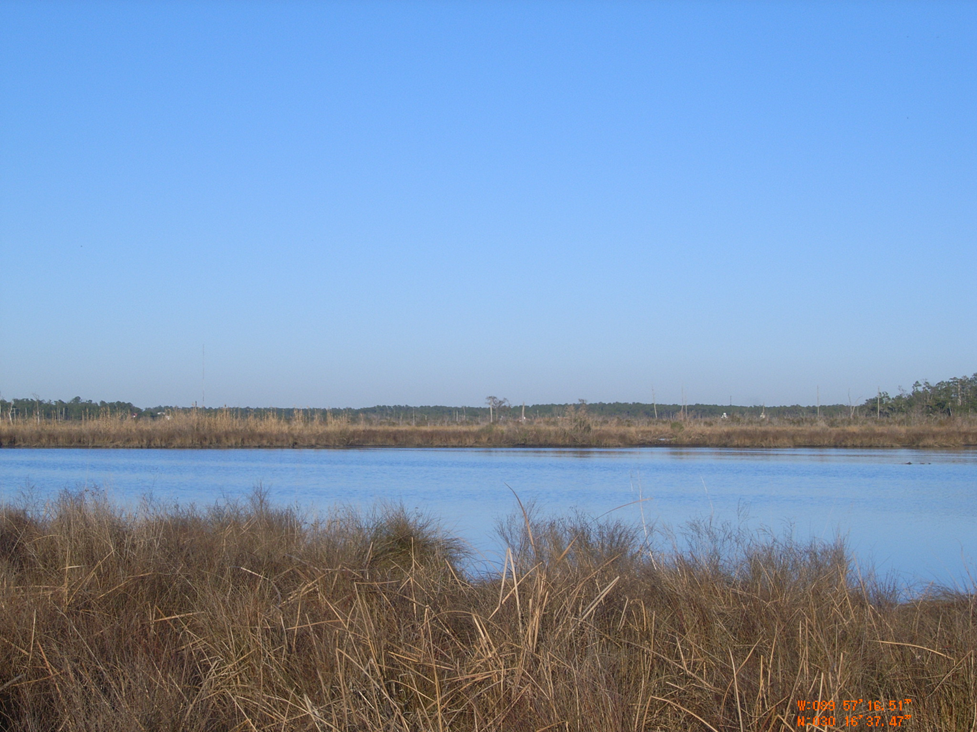
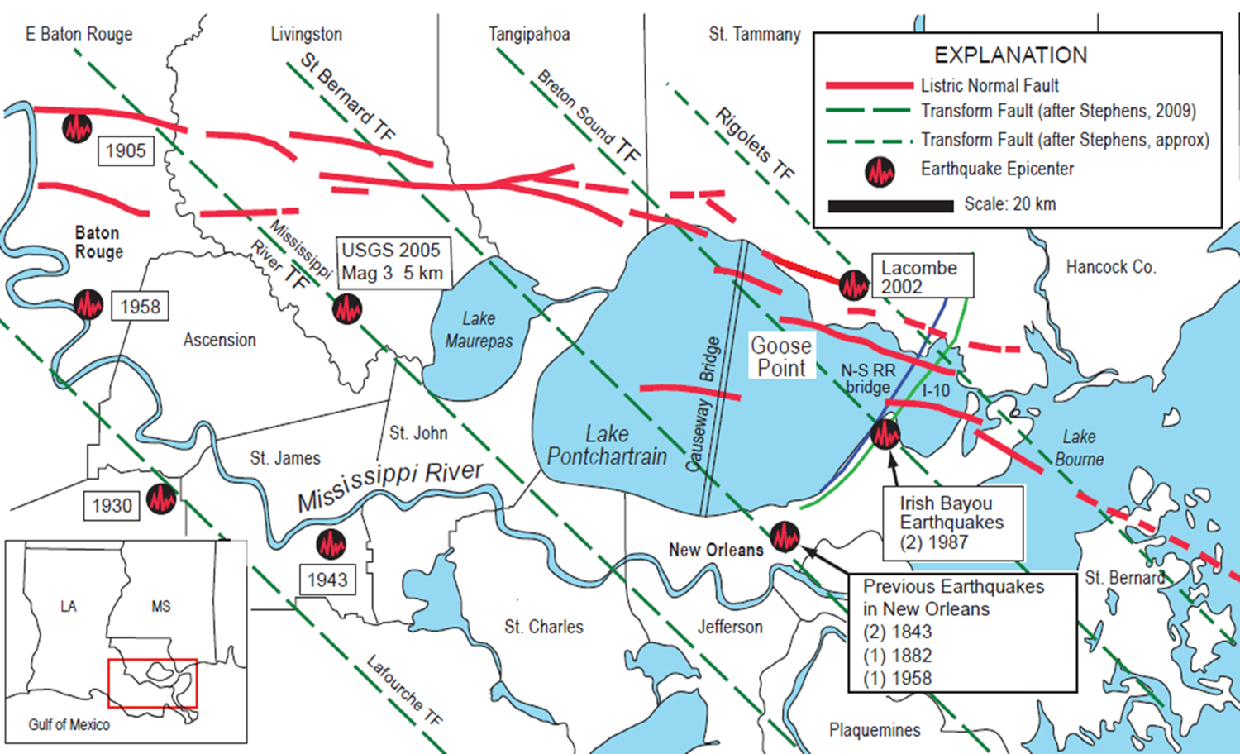
Regional Tectonic Setting
After Gagliano
2003
12 mi
After Kulp et al 2002 and Heinrich 2004

Slide 6
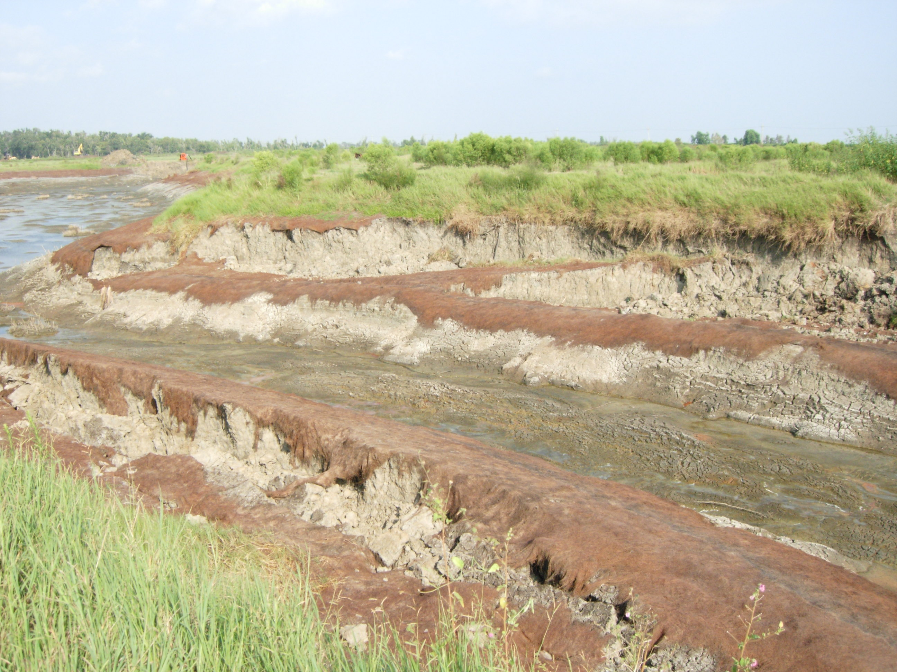
Notes:
This is what a slump looks like. This is a portion of a drained lake. The banks have collapsed towards each other. Note how the soil tears away from the banks and slides down slope. The soil does not all move as a single unit. There are many blocks or segments.

Slide 7
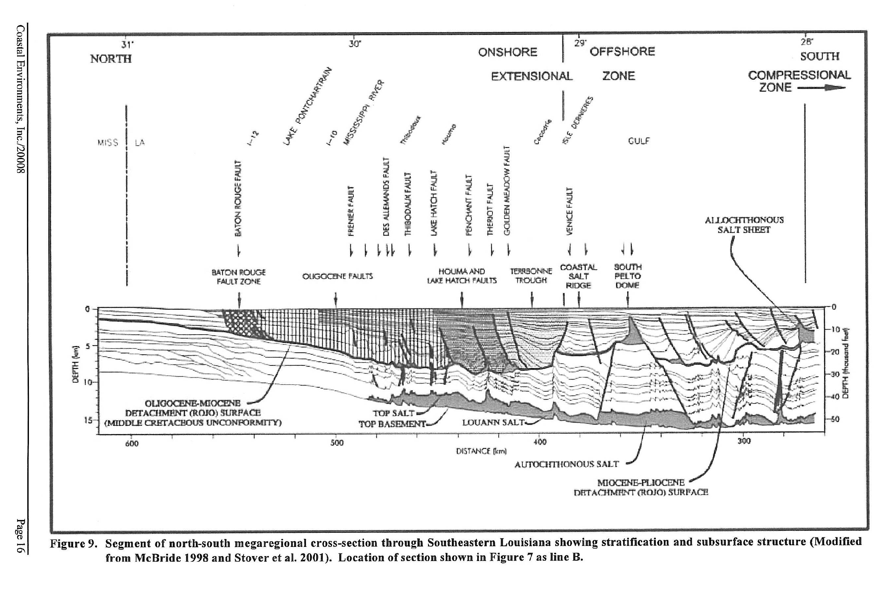
Baton Rouge Fault
Notes:
Seismic data shows how sediments interact with fault planes along a transect from Baton Rouge to the mouth of the Mississippi River. Listric faults move sediment along like great conveyor belts down slope and out into the Gulf.

Slide 8
After Dokka 2005

Slide 9
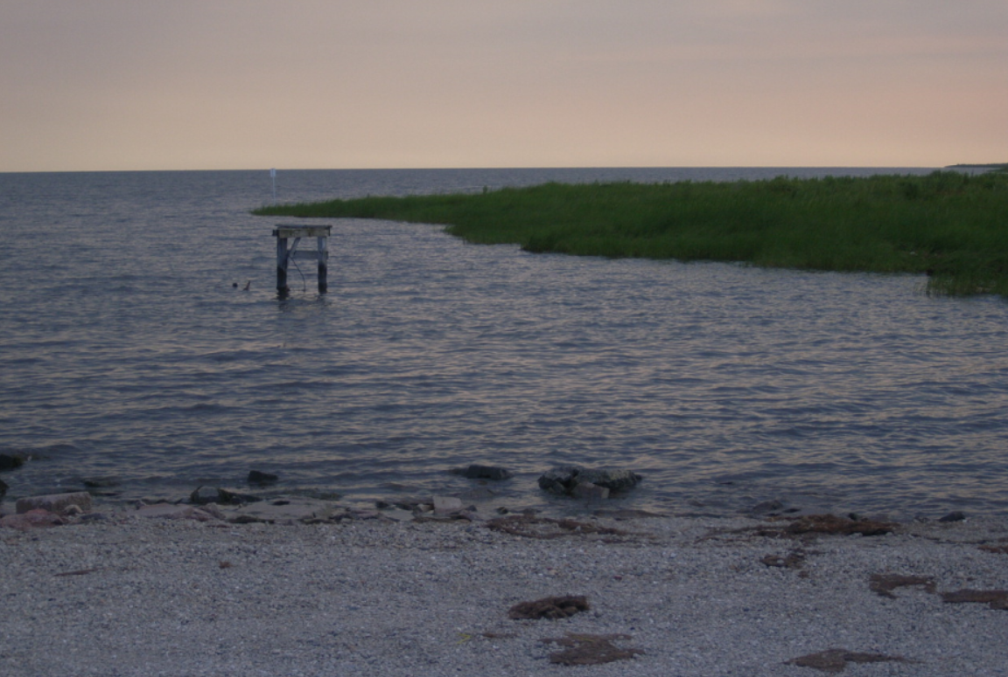
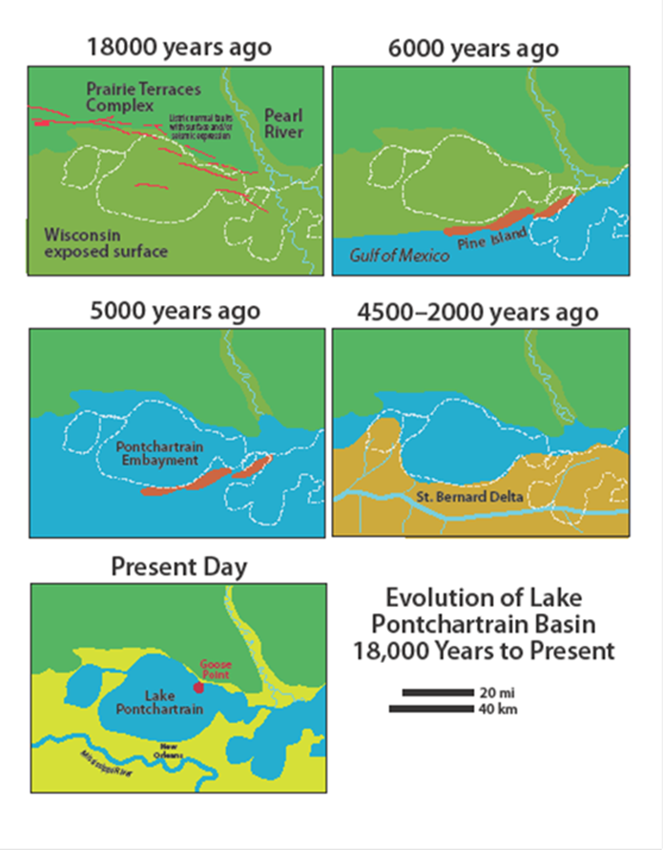
After Kindinger 1998

Slide 10
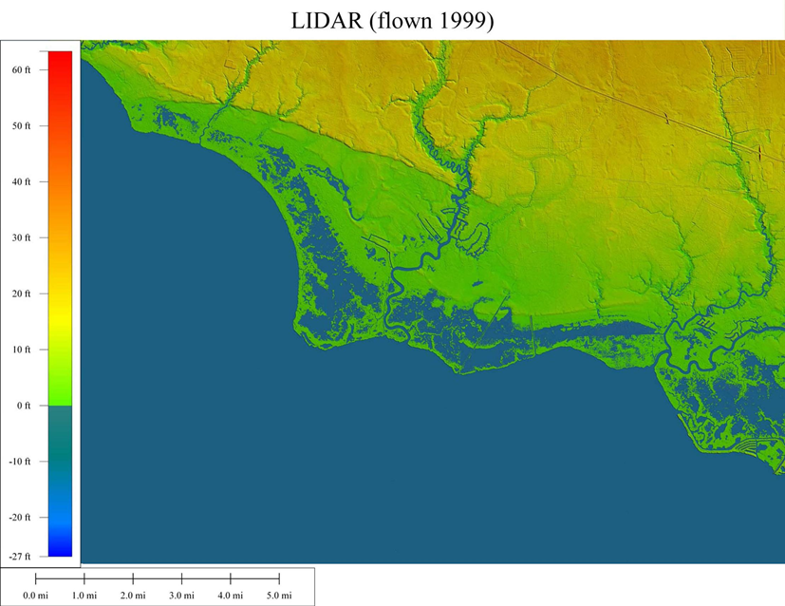

Slide 11
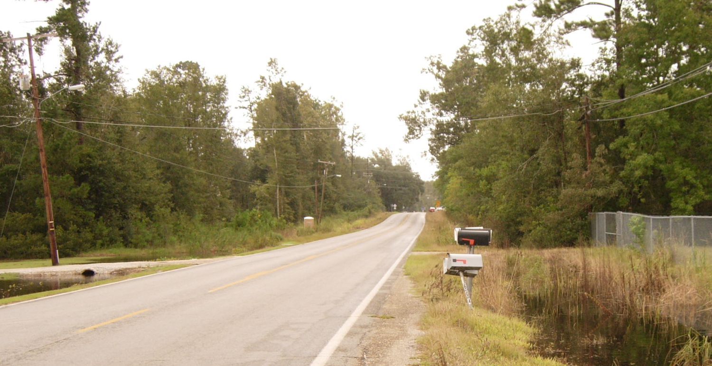
Baton Rouge Fault System
Lacombe Segment Fault Trace

Slide 12
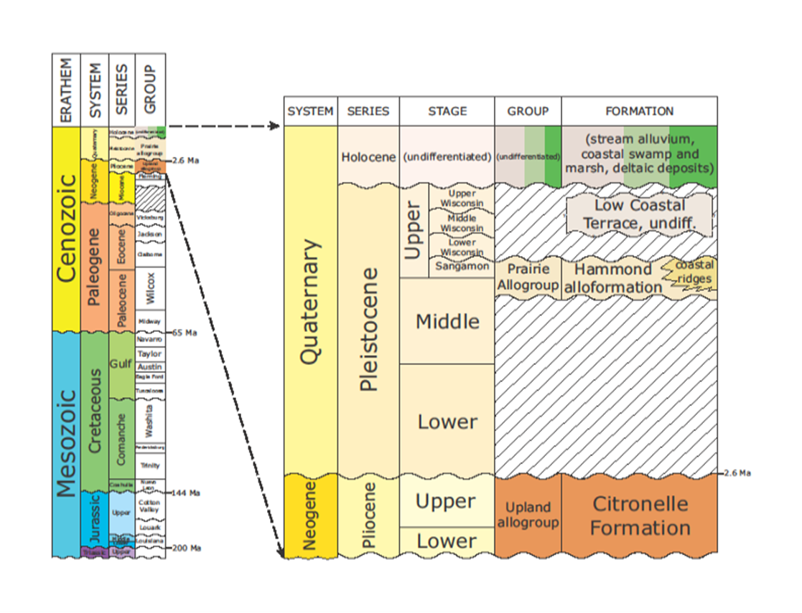
Age of the Sediments at Lacombe and Goose Point
McCulloh and Heinrich 2011

Slide 13
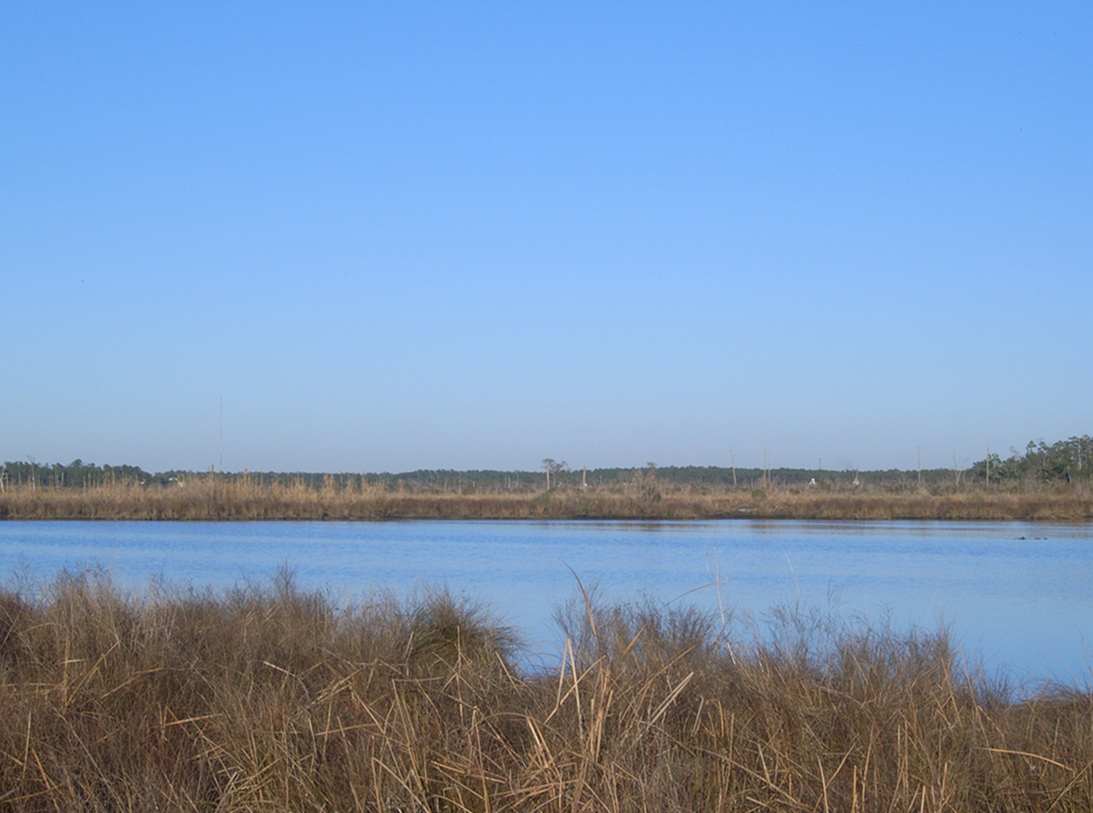
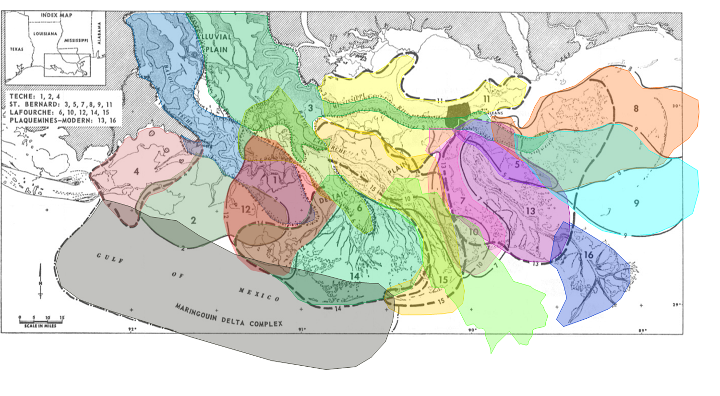
Frazier’s 16 Deltas . . . (Wax Lake No. 17)
After Frazier 1967 from McLindon

Slide 14
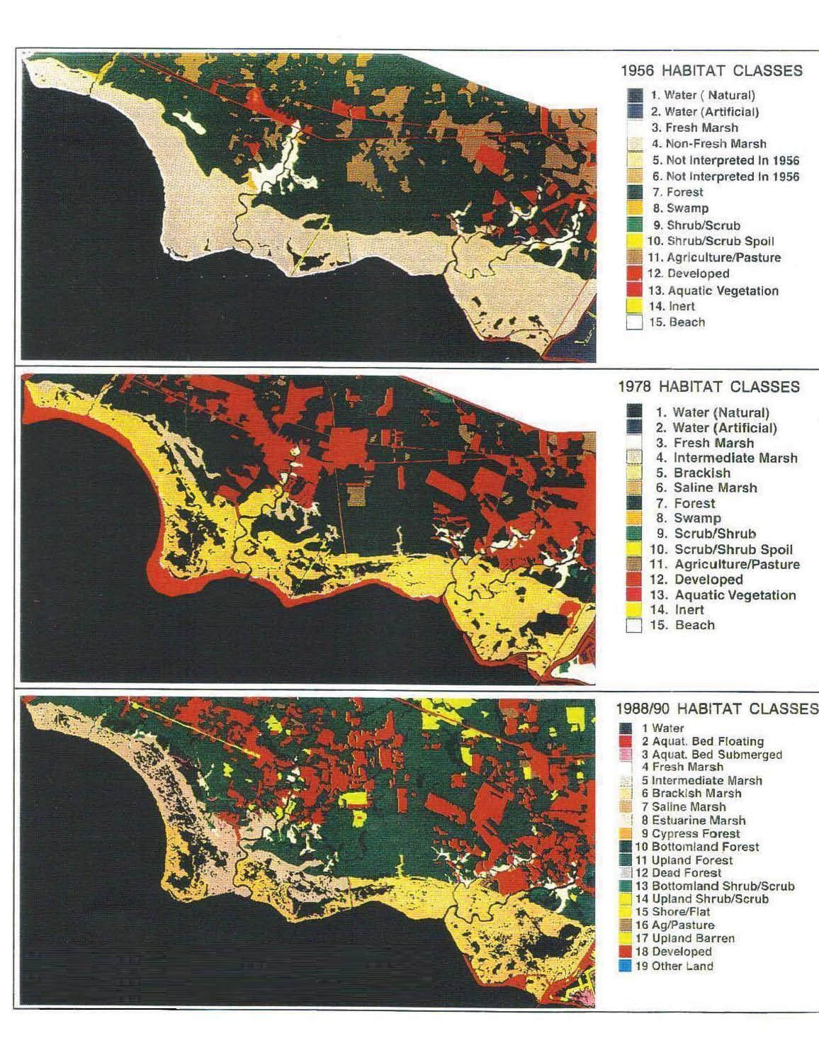
1956
1978
1988-90
Chabreck and Linscombe 1956-1990
Notes:
These habitat maps were made by Chabreck and DeLaune between 1956 and 1990. They show a pattern of subsidence typical of coastal marshes. Look back at slide 3 -the aerial of the lake from the early 1990’s. Note the same pattern of break up around the lake and in the marshes of Orleans, St. Bernard, Plaquemines, and Jefferson. A bigger map would show more of the same pattern.

Slide 15
Factors Influencing Land Change

Slide 16
Anthropogenic Causes of Coastal Land Loss – Not Present at Goose Point
No Large Scale Fluid Extraction -
No industrial / water wells
    No O&G wells
No E&P Canals
No Levees or forced drainage
No Deep draft channels
No Ancestral Mississippi River Delta Sediments

Slide 17
Natural Coastal Processes
At Goose Point
Listric faulting associated with the Baton Rouge Fault System
Regional crustal down-warping
Earthquake activity
Sediment compaction of Holocene and Pleistocene
Sea Level Rise
Storm Surge

Slide 18
Anthropogenic Alterations of the
Goose Point Marsh
Marsh Burns

Slide 19
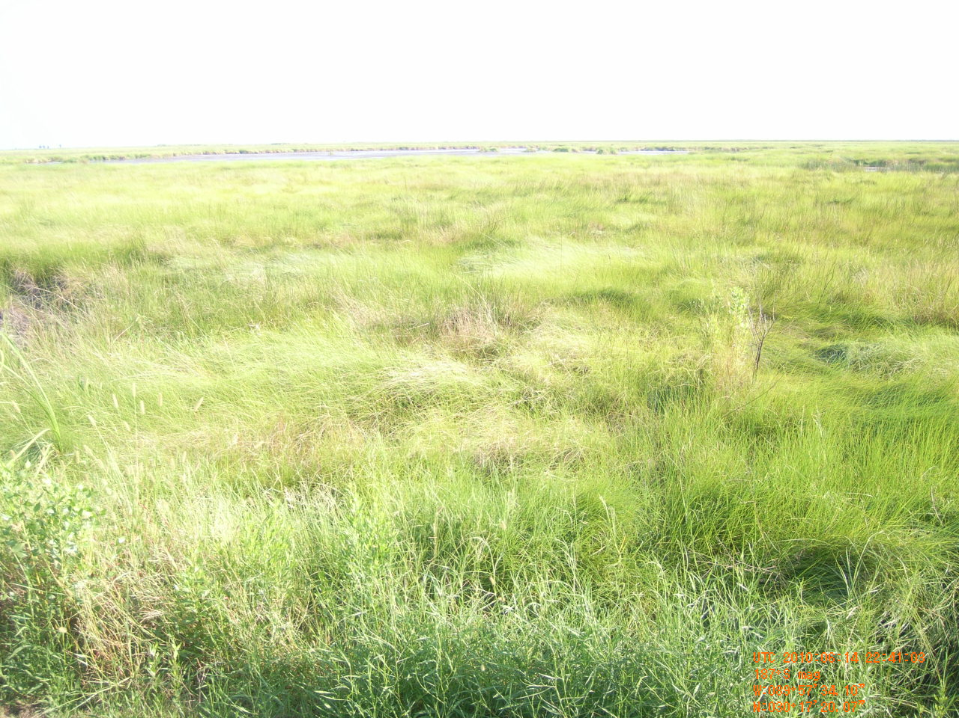
Important Distinctions about
Salt, Water and Plants
These stressors, salt and water, can work independently or jointly to kill plants.
To kill a coastal plant with salt water intrusion, you must exceed the salinity limit of that individual species.
Water tolerance is species specific and has an optimum range and limits.
Duration of inundation modifies or intensifies salinity or water effects.

Slide 20
Salinity Gradient from Lake Maurepas to the Chandeleur Sound
After Georgiou et al. 2007

Slide 21
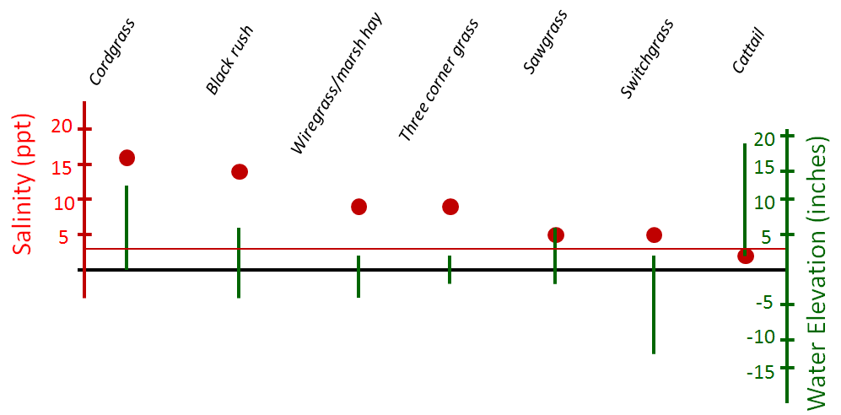
Salinity and Water Depth
Lake salinity about 4ppt

Slide 22
Marine Transgression
For any kind of water to move over marshes from the Lake or GOM. . .
the marsh must be subsiding or sea level
must be climbing, or both - RSLR.

Slide 23
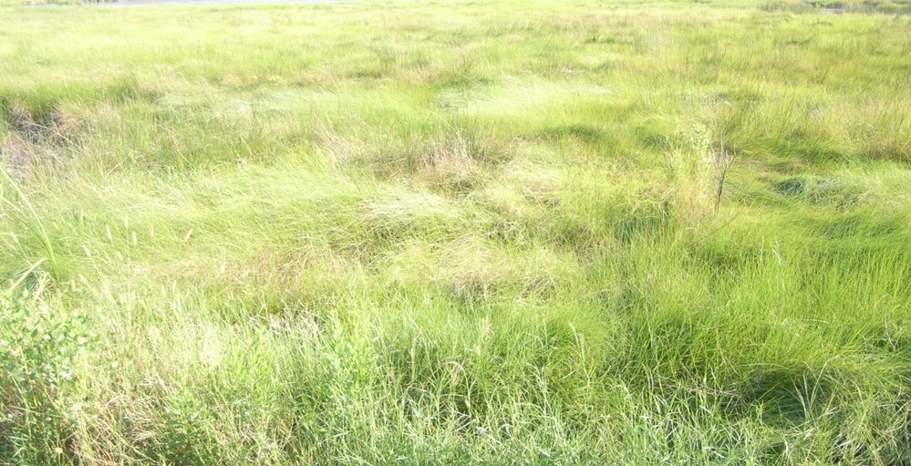
Signatures of tectonic driven subsidence/faulting in the marsh
Changing vegetation / Thinning vegetation
Ponds that get bigger over time
Bayou channels that change shape -
tight meanders or balloon
Actual submerged features - spoil berms, rail road tracks, foundations of structures, the marsh itself

Slide 24
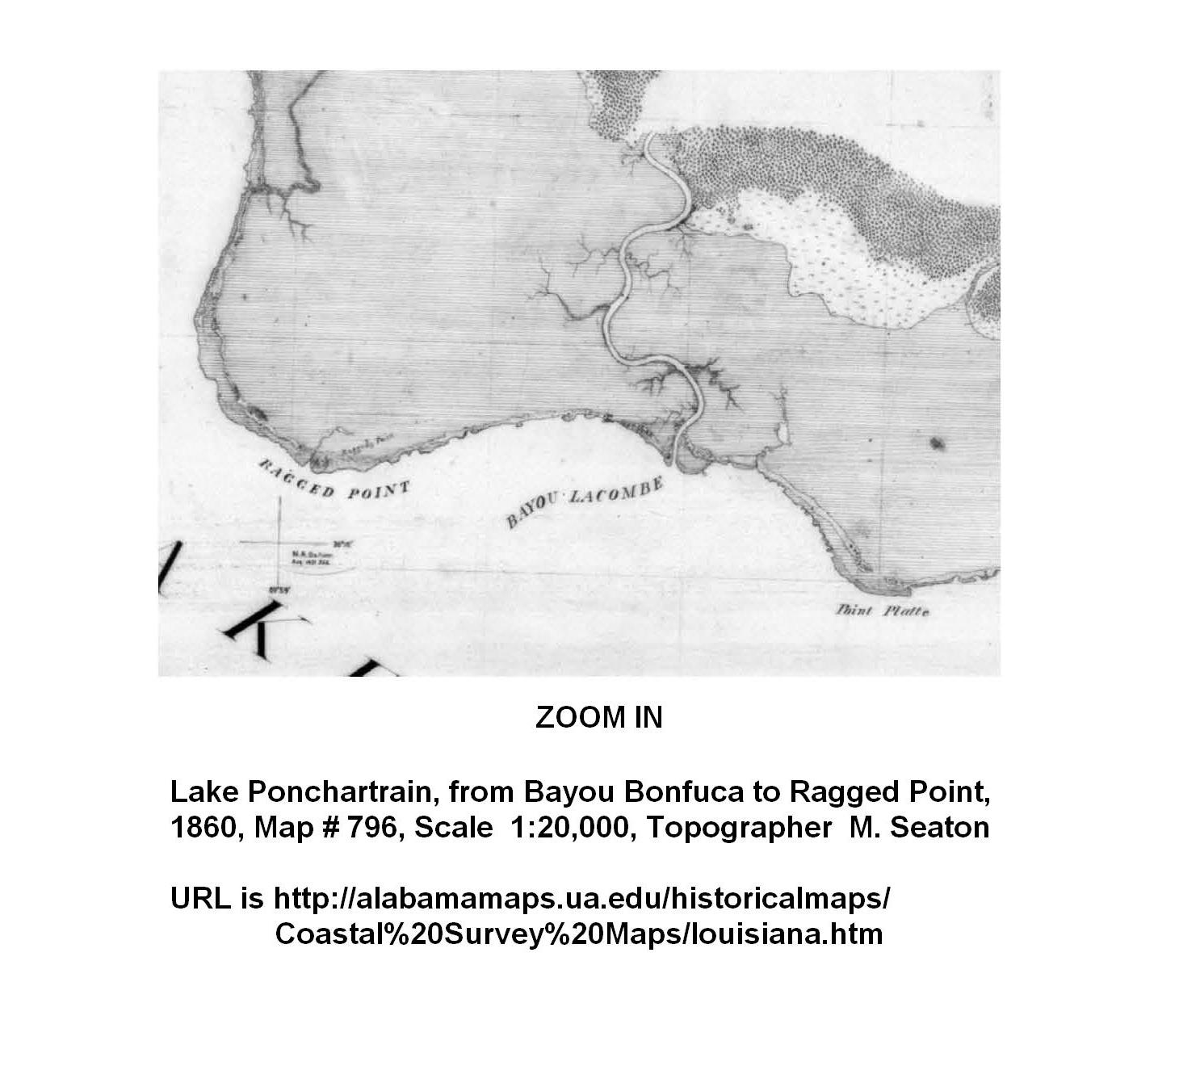
1860 Map
Notes:
Goose Point has undergone considerable change over time. In 1860 The marsh was high and tight. Ragged Point is the place we know today as Goose Point.

Slide 25
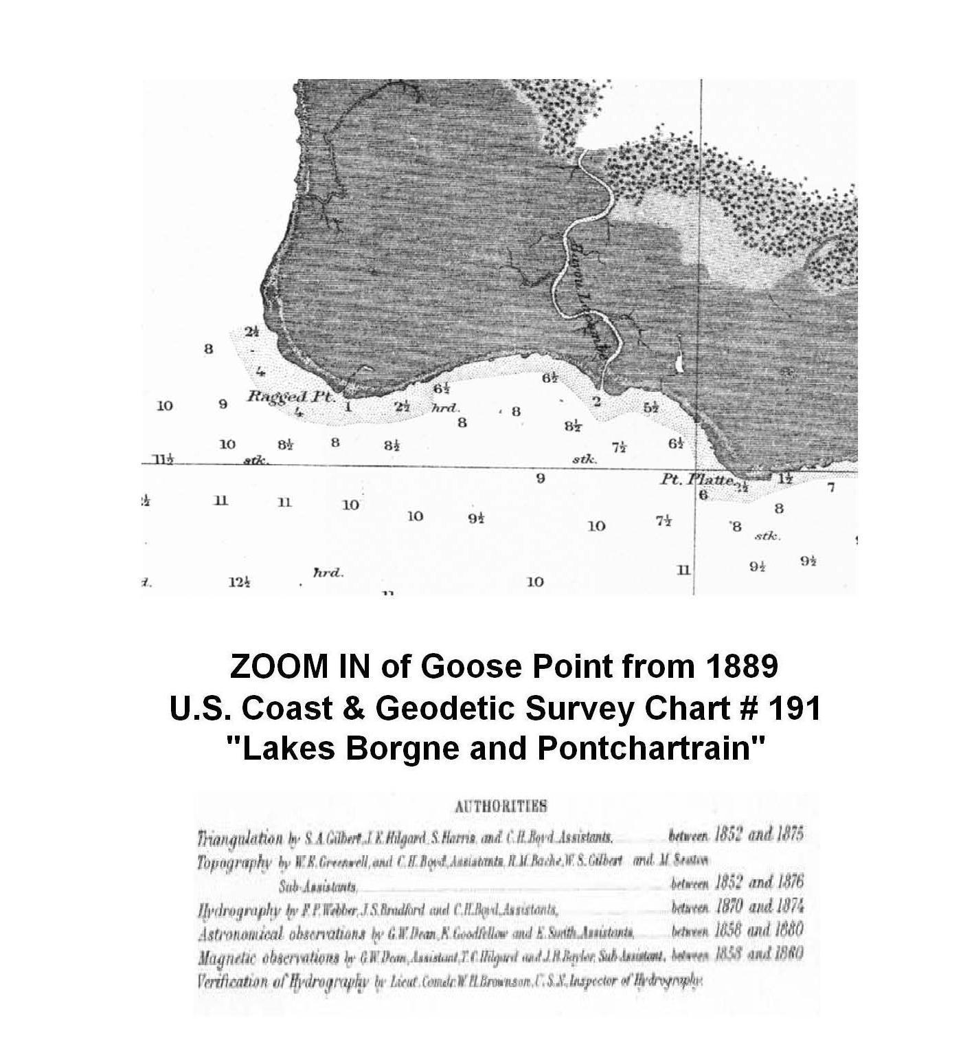
1889 Map
Notes:
Compare this map with the 1956 map in the following series of Habit Maps. By 1956 the process of subsidence had begun but was effecting only the distal areas of the marshes in Goose Point and Point Platte. Most of the interior of the marsh was still tight in 1956.

Slide 26
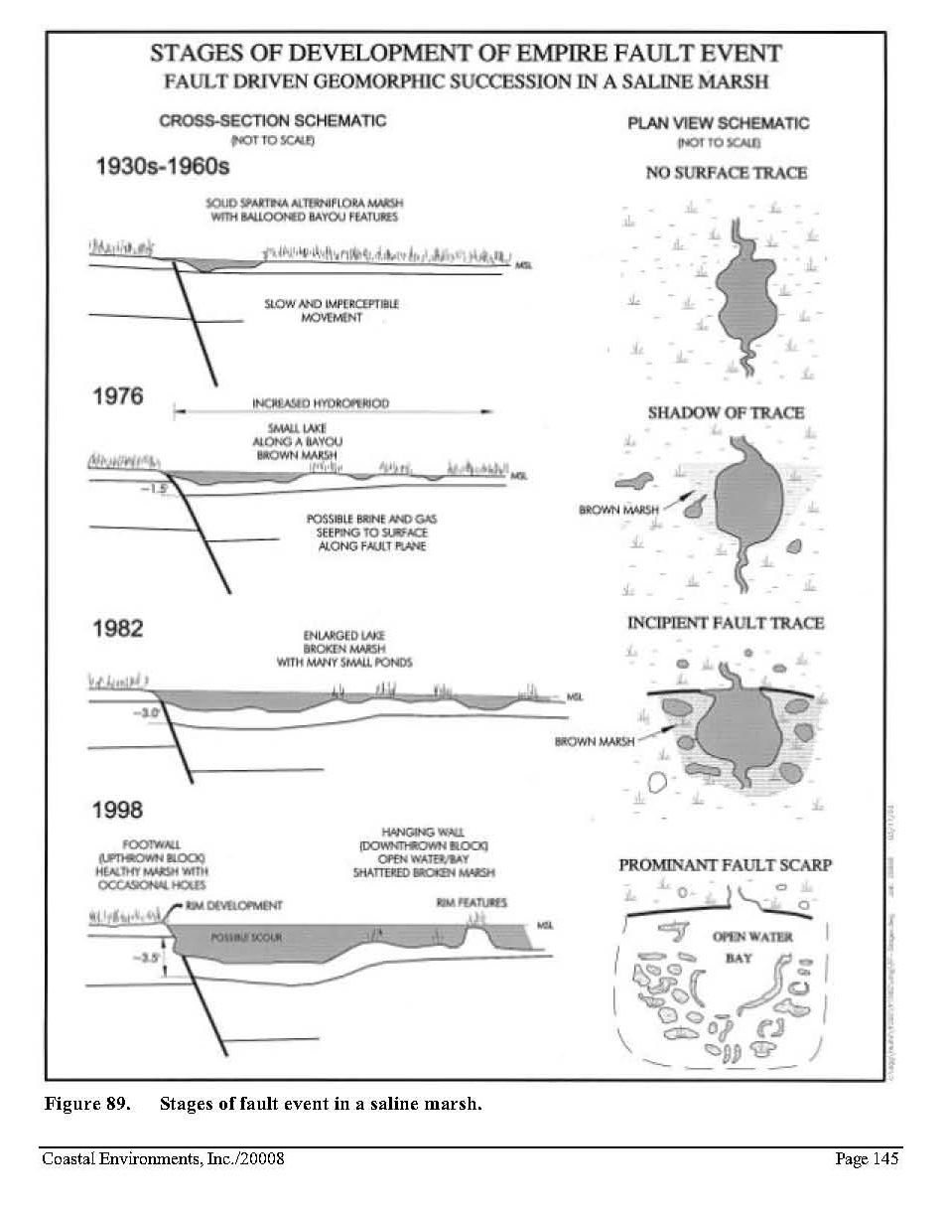
Notes:
The Empire Fault is an excellent model for coastal faults with a well developed zone of deformation. Attempting to fill in the zone of deformation associated with coastal faults is neither cost effective nor sustainable.

Slide 27
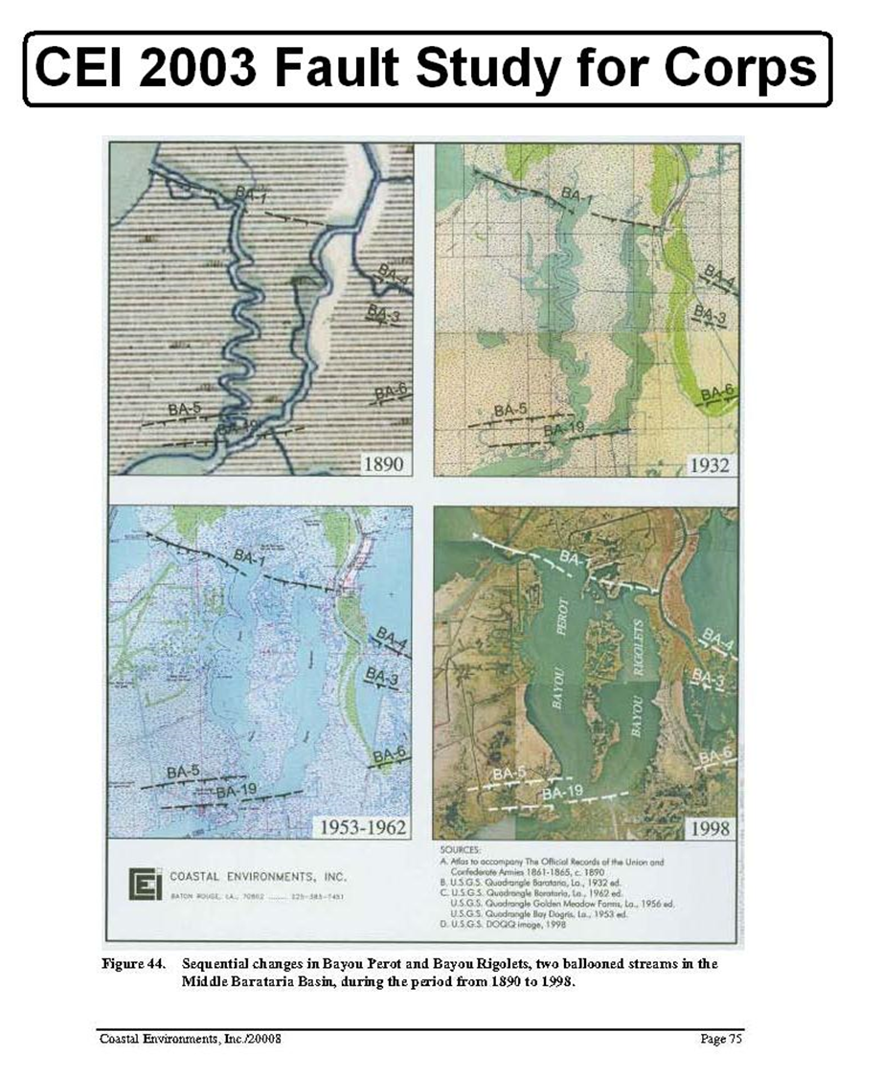

Slide 28
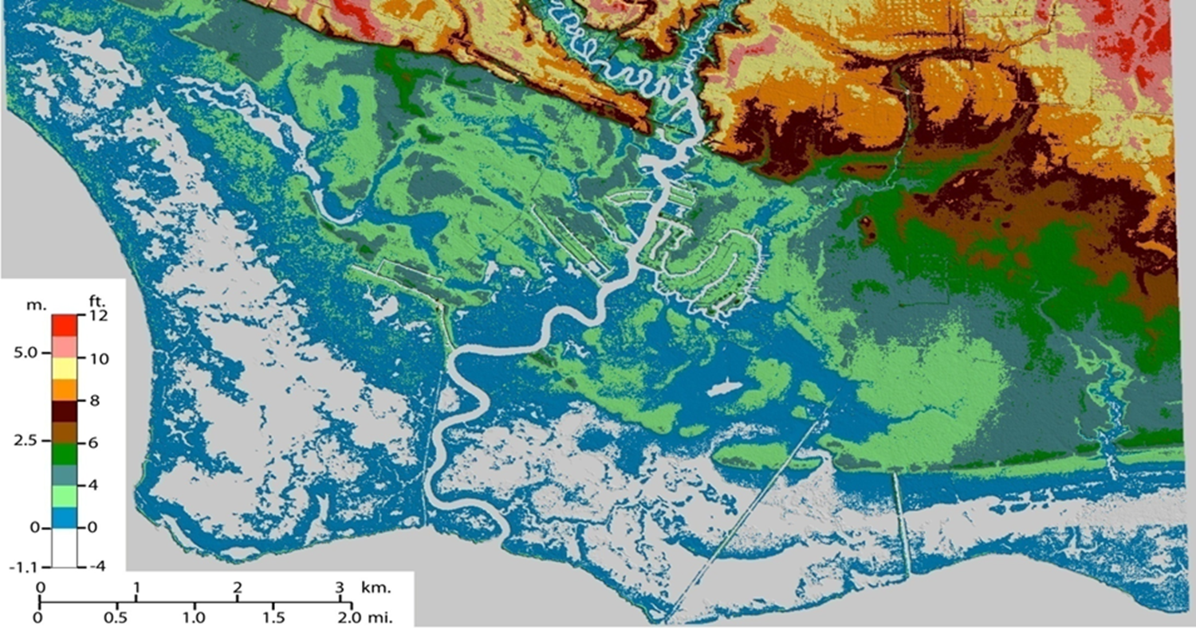
Tammany Trace
LacombeFault Trace
Bayou Lacombe
Goose Point
Point Platte

Slide 29
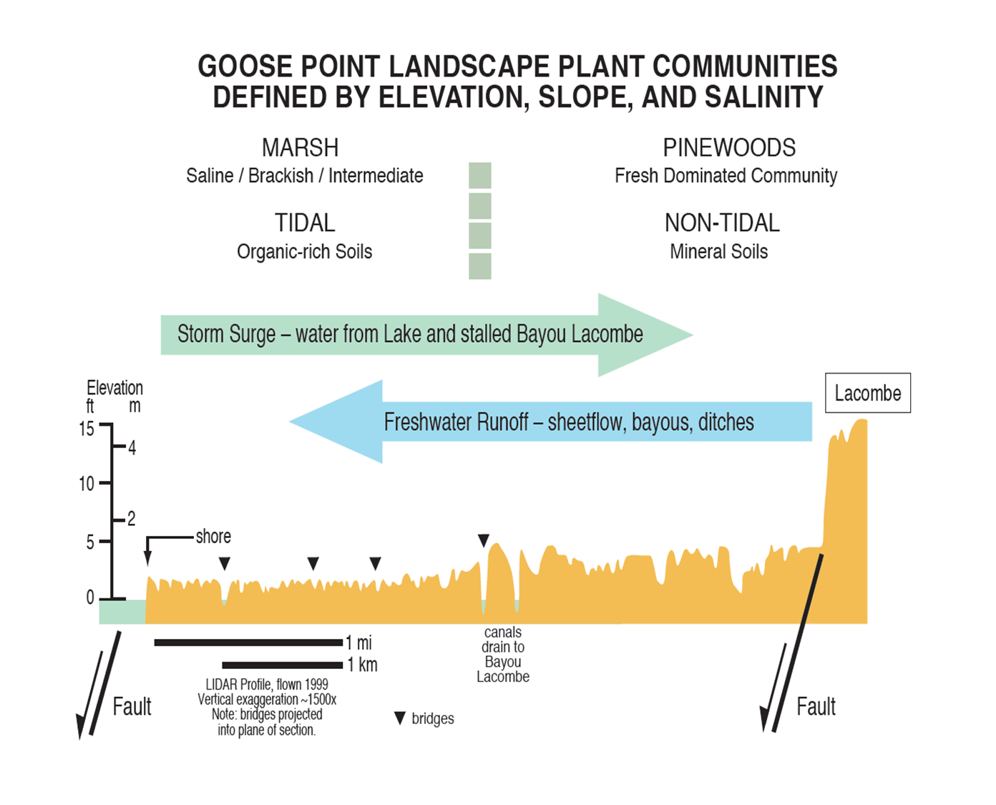

Slide 30
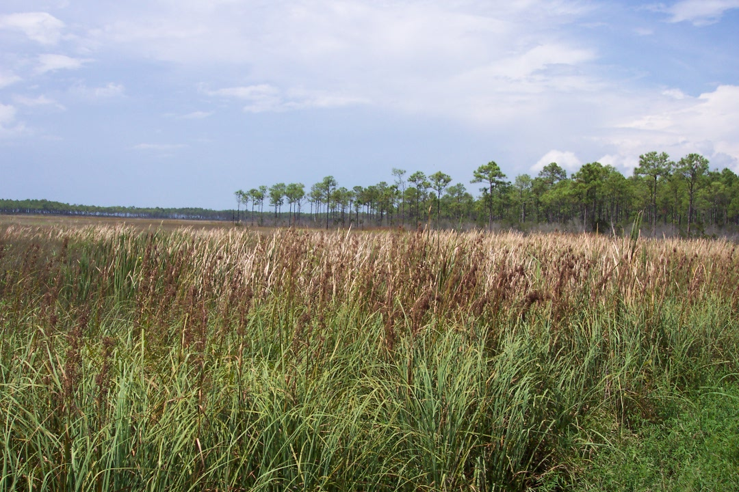
Goose Point - 1998
Notes:
This is the first of 4 pictures taken in about the same location looking west on Lake Road between 1998 and 2010. Note how the vegetation changes over time. In 1998 there is a broad stand of Cat Tails with Saw Grass.

Slide 31
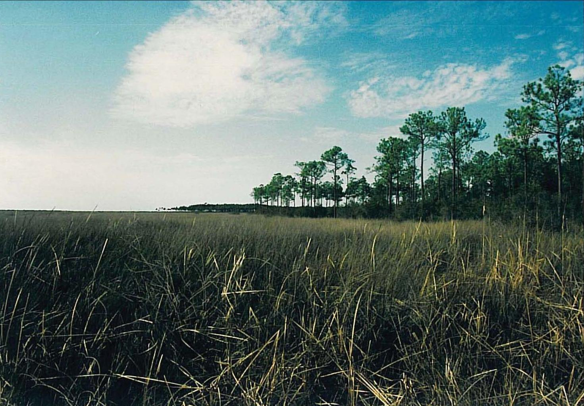
Upper Goose Point Marsh - 2002
Notes:
In 2002, pre-Katrina, The Cat Tails are diminished and Black Rush is well established in the Spartina patens. There is still a well developed understory to the pines in the foreground.

Slide 32
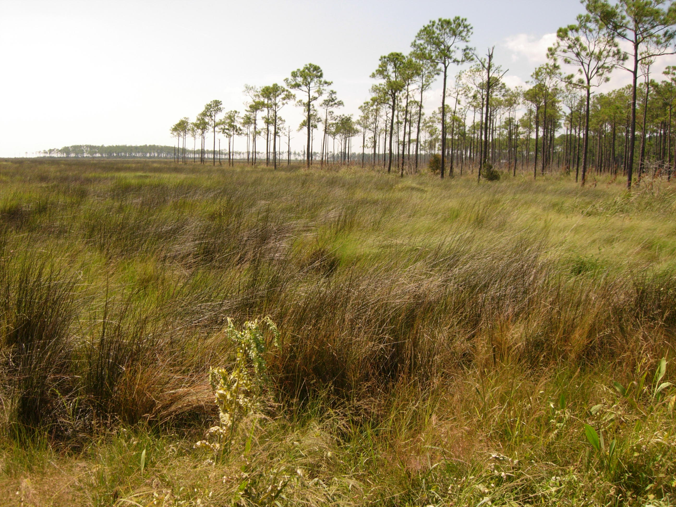
Goose Point – 26 Sept 2008
Notes:
Post Katrina, 2008, shows a marked change in the vegetation. The Cat Tails and Saw Grass are virtually gone. The Black Rush had replaced them. The shrub strata has been replaced by the Spartina and Saw Grass that runs beneath the pines. The Saw Grass has moved to higher ground.

Slide 33
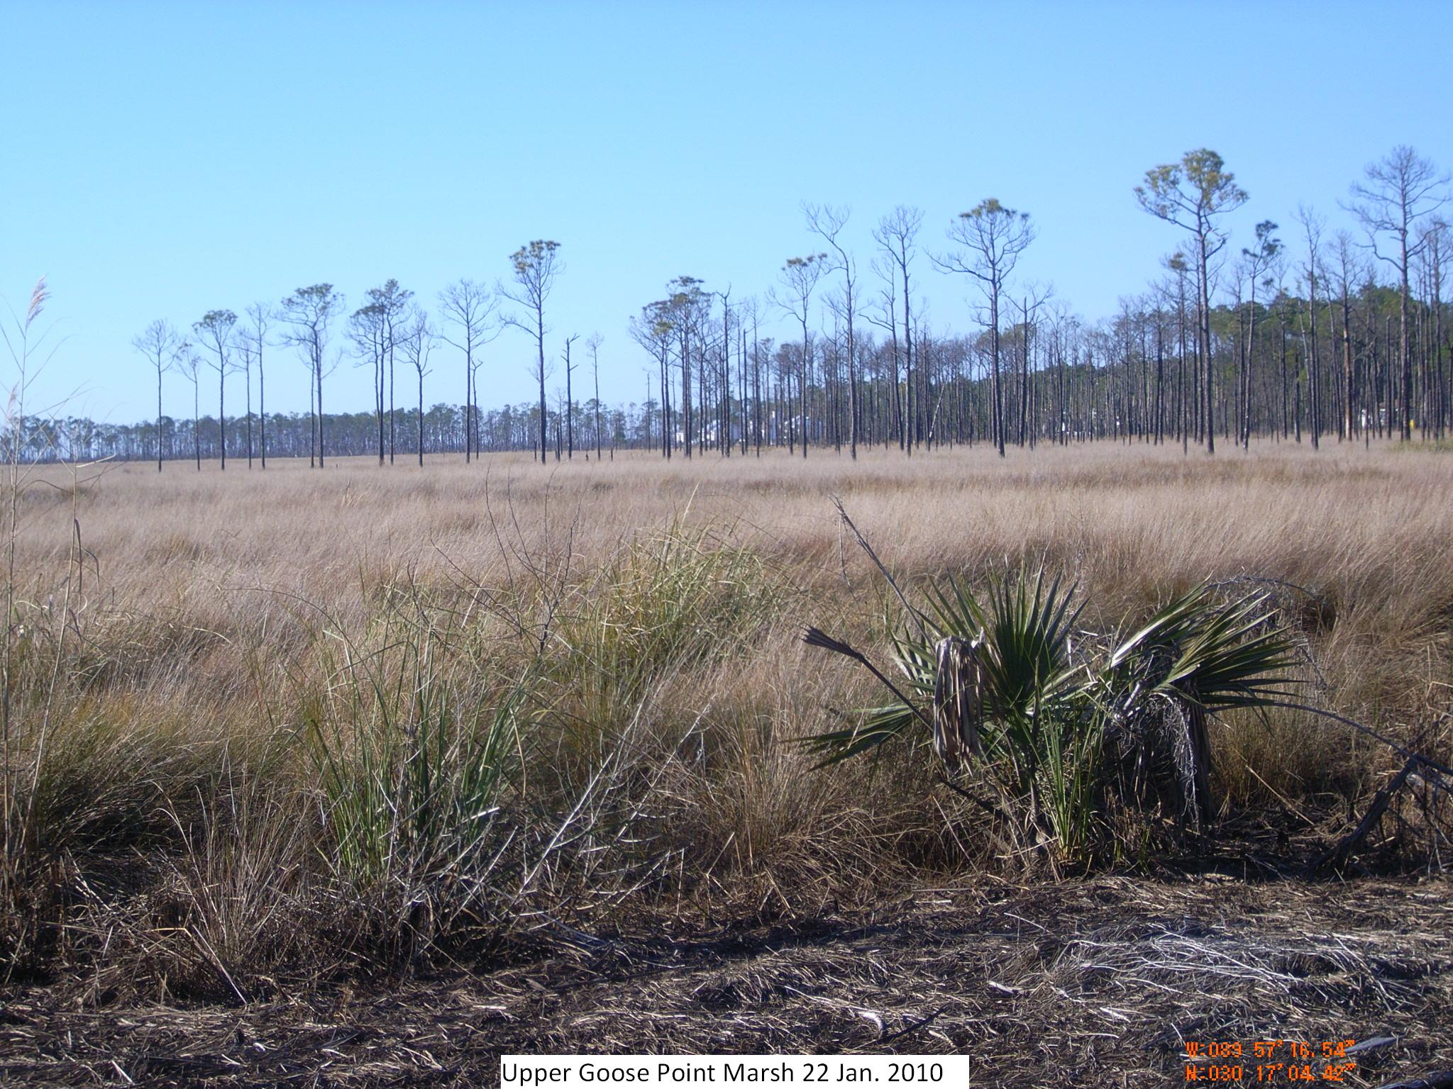
Upper Goose Point Marsh – 22 Jan 2010
Notes:
Post burn following hurricanes Gustav and Ike. The pines were burned to their crowns by the intense fire that consumed feet of wrack in the upper marsh. Most of these pines are now dead. The first flush of vegetation was almost entirely Spartina patens. The dark areas are Black Rush growing slower than the Spartina. The Black Rush can grow in the lower and saltier places.

Slide 34
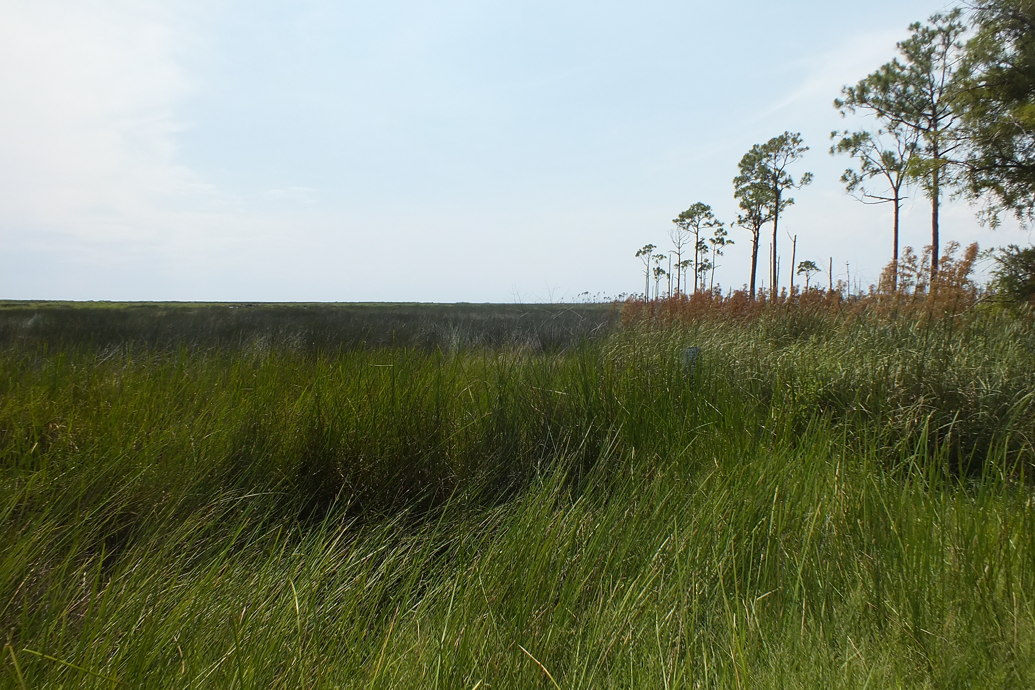
Upper Marsh 22 June 2013

Slide 35
If the model in your head is wrong…

Slide 36
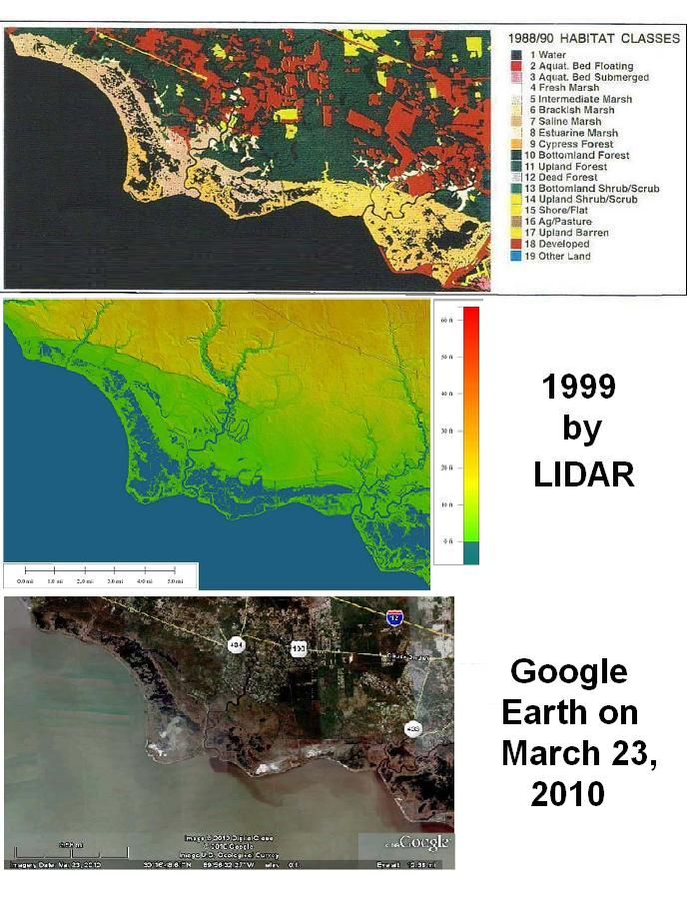
Notes:
Continuing the sequence of maps that show continuing marsh loss in and around Goose Point are 1988-1990, 1999, and 2010. The marshes are more open with each successive map. Subsidence is continuing along with more destruction from passing storms.

Slide 37
Summary
Goose Point is typical of coastal land loss –
- due to natural causes -
crustal down-warping
faulting and sea level rise
Coastal plant community changes signal
loss of elevation preceding land loss

Slide 38
Thank you for your time!

Slide 39

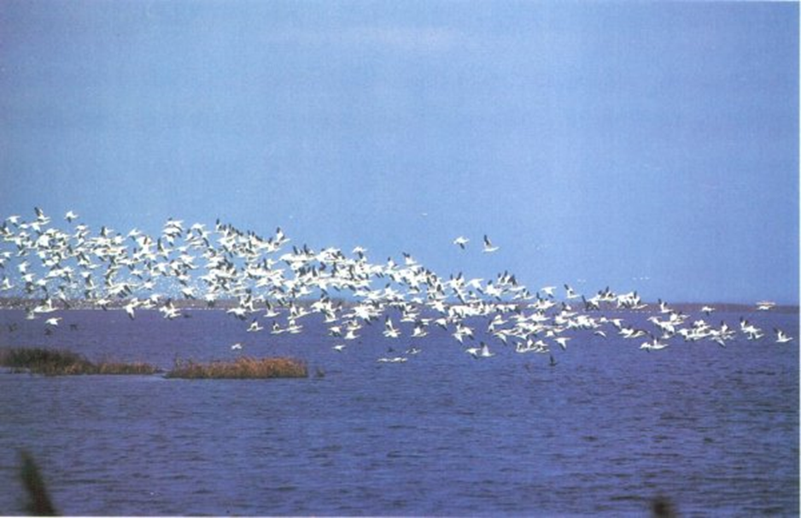


(Gagliano et al., 2003)
Louisiana geese

Slide 40


Slide 41
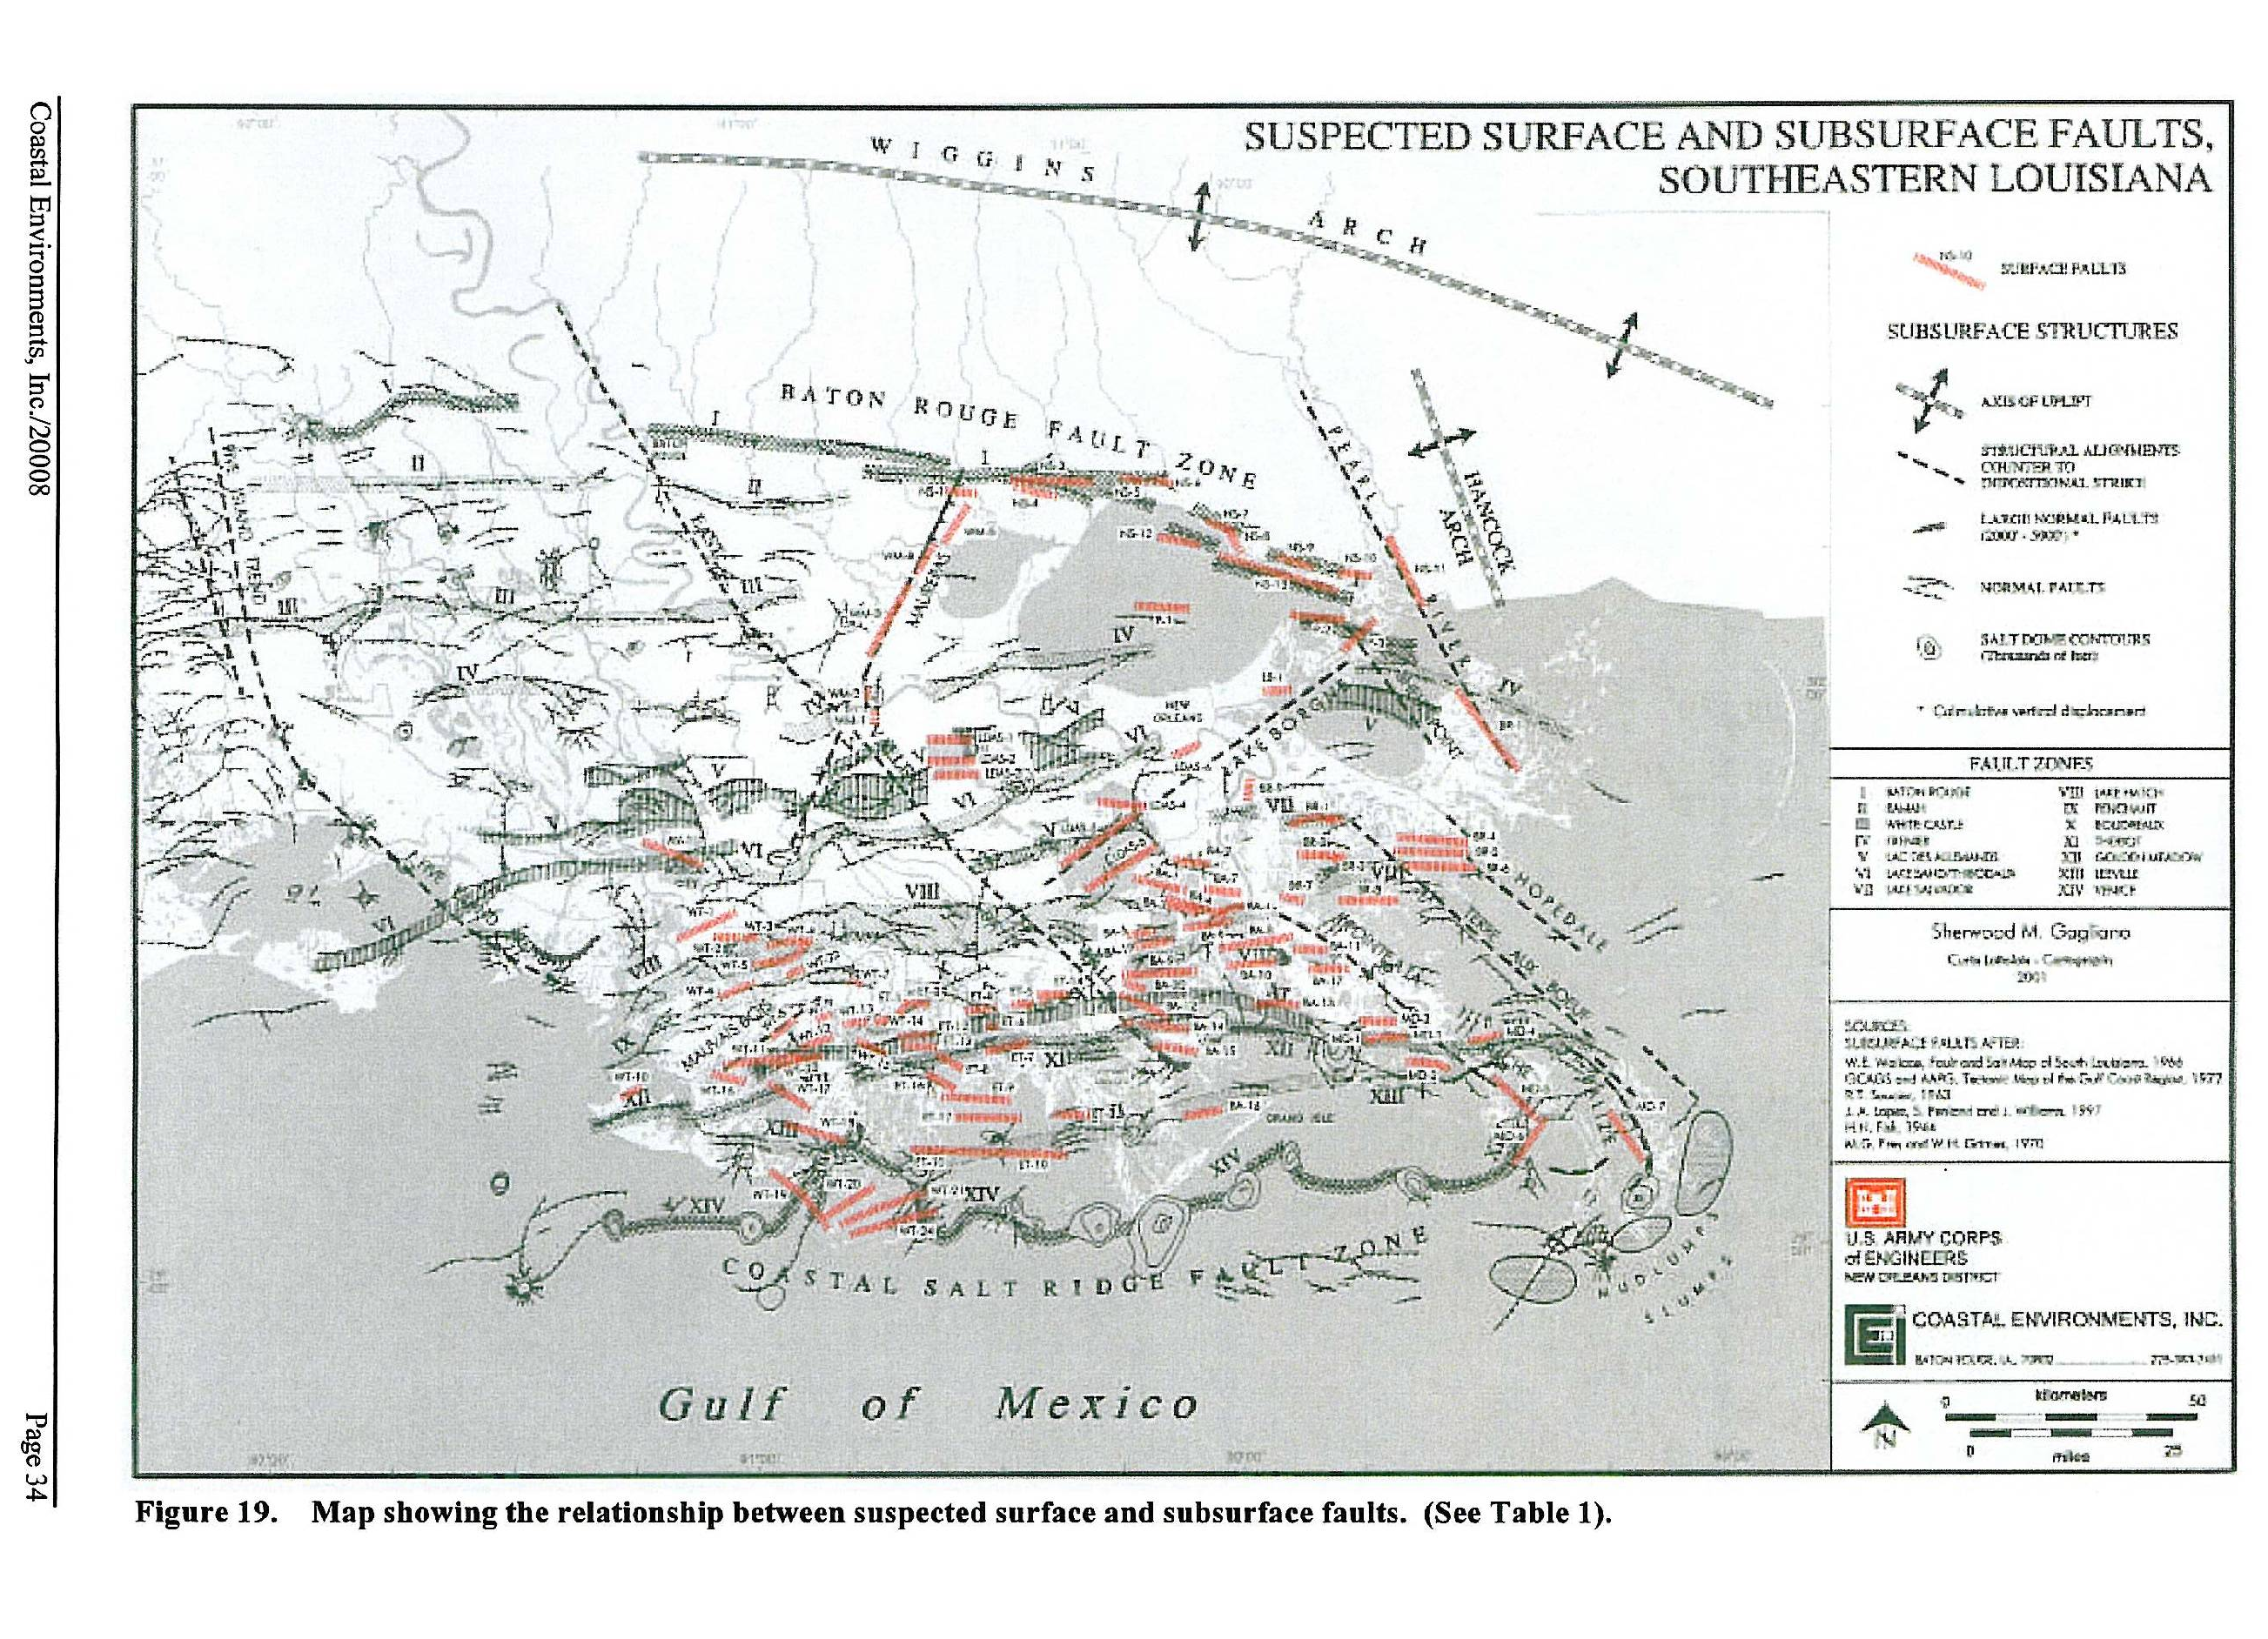
From Gagliano et al, 2003
Notes:
Fault Map from the Fault Study for the NOD-COE by Coastal Environments, Inc. (2003). Kathy (Wiltenmuth) Haggar was one of four co-authors of the fault study and conducted much of the field work documenting recent fault activity in southeast Louisiana. This map shows many faults that are known from well data and seismic as well as some features that are suspected from LIDAR.

Slide 42
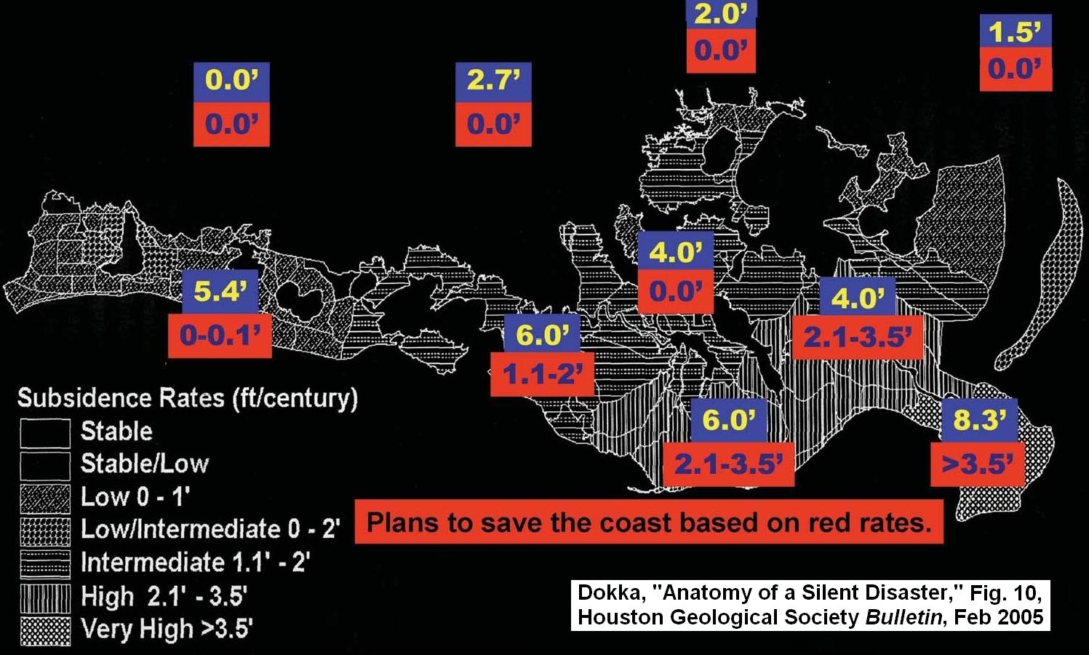
Measured Subsidence Rates
Notes:
Elevations are being monitored across the coast (and around the world) by sophisticated elevation/location systems utilizing satellite technology based CORS stations, (Continually Operated Reference Stations). These stations are up to the minute bench marks. The blue numbers are feet per century subsidence based on CORS data. The numbers in red are the subsidence rates used to justify coastal restoration projects.
These numbers should not be so far apart and should be blue if only one set can be used.

Slide 43
If -
a plant species is adapted to the
salinity introduced by-
Storms
Canals
RSLR
SLR
Then -
plant will not die from salt water

Slide 44
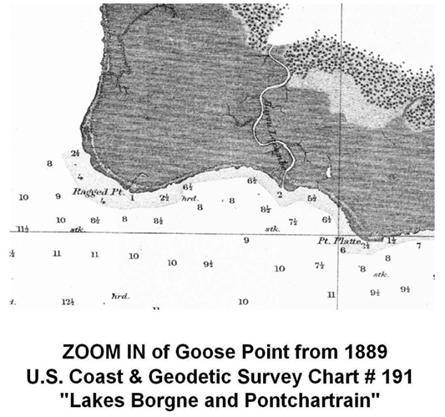

Slide 45
1996-2006
Wetland loss and changes in land cover:
Open Water 12% Bare Land 25%
Agriculture 27% Developed 36%
Goose Point
Mississippi Coastal Watershed from USGS modified by K.H.
http://water.epa.gov/type/wetlands/upload/gulf-of-mexico-review.pdf

